Slide 1

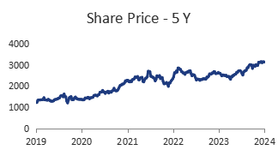

Academic Research Project – Not a recommendation
EQUITY RESEARCH REPORT
PIDILITE INDUSTRIES LTD.
NSE : PIDILITIND | BSE Code: 500331
ABOUT THE COMPANY
COMPANY DATA
Pidilite Ltd. was established in 1969 as a manufacturer and marketer of adhesives and is among the biggest companies in the Indian subcontinent dealing in the same products. Popular across the country for its broad portfolio of products: civil construction chemicals, waterproofing products, sealants and art material.
The company currently dominates the Indian market; however, it is gradually venturing into other South Asian, Middle Eastern, and Southeast Asian countries. Some of the major international subsidiaries of the company are based in United States, Bangladesh, Sri Lanka, Thailand, Egypt and Dubai.
The Pidilite Industries Ltd is a diversified company with more than ₹5000 crore worth of its product portfolio with its business revolving round two major divisions namely; branded consumer and bazaar as well as business-to-business. Fevicol, Dr. Fixit, M-Seal, Hobby ideas etc. , have become the hall mark of the company and the market leader.
CMP
INR 3150
Book Value
INR 165
Market Cap
160230 Cr.
PE Ratio
89.9
High/Low
3245/2293
ROCE
29.7%
ROE
22.8%
SHAREHOLDING PATTERN
GROWTH TRAJECTORY
The Company’s Market Capitalisation has grown from 46,606 crores as on 31st March, 2019 to 1,53,330 crores as on 31st March, 2024, giving a Compounded Annual Growth Rate (CAGR) of 21.93%.
Pidilite was recognised as one of Interbrand’s Top 50 Most Valuable Brands of India and was ranked amongst the Top 25 Manufacturing & Chemical companies by the Great Place to Work.
CONCALLS HIGHLIGHTS
Pidilite is getting ready for net phase of growth: 36 capacity building projects (7 Greenfield & 29 Brownfield, of which 17 are completed till Mar’24) and several other projects aimed at improvements in productivity, quality, safety and environmental parameters are under progress.
Value growth lagged behind UVG due to pricing actions from softer input prices; however, the gap between value and volume is narrowing.
The management remains cautious about future pricing, dependent on geopolitical and raw material market conditions. VAM prices currently fluctuate between $850 and $1,000 due to market conditions.
Rural markets continue to outpace urban markets, with significant penetration opportunities identified. 90% of rural growth attributed to same-store sales growth, indicating strong brand penetration rather than one-time stocking events.
Over the last 5 years, capex has increased significantly, with a focus on core and pioneering categories. Current capacity utilization remains between 70% and 75%; expansions are ongoing in 20 plants.
Particulars
Mar-24 (Cr)
Mar-23 (Cr)
Revenue | ₹ 9,921.0 | ₹ 11,799.1 | ₹ 12,383.0
EBITDA | ₹ 1,896.3 | ₹ 2,025.0 | ₹ 2,753.2
PAT | ₹ 1,207.6 | ₹ 1,273.3 | ₹ 1,729.4
Earnings Per Share | ₹ 13.8 | ₹ 14.0 | ₹ 18.0
Retained Earnings | ₹ 699.3 | ₹ 714.1 | ₹ 915.6
ROE (%) | 18.86% | 17.65% | 20.57%
Debt/Equity (x) | 6.49% | 5.42% | 4.55%
Particulars Mar 22 Mar 23 Mar24

Slide 2
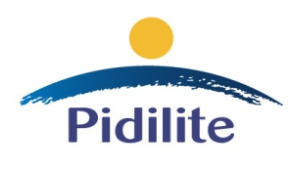
EQUITY RESEARCH REPORT
PIDILITE INDUSTRIES LTD.
Content
Business Model
Credit Analysis
Tax Risk Analysis
Corporate Governance
Shareholding Pattern
Pestel Analysis
BCG Matrix
Porter’s 5 forces
SWOT Analysis
Balance Sheet Analysis
Income Statement Analysis
Cash Flow Statement Analysis
Ratio Analysis
DuPont Analysis
The Warren Buffet’s $1 Test
Coffee Can Investing

Slide 3
EQUITY RESEARCH REPORT
PIDILITE INDUSTRIES LTD.
BUSINESS SEGMENT & PRODUCT PORTFOLIO
% OF TOTAL SALES
Pidilite industries have various iconic brands under them, which include Dr. Fixit, Roff, Araldite, Fevicol, Fevistick, Fevicryl, Fevigum, Rangeela, Fevikwik, M-Seal, WD40, Motomax, Terminator, Wudfin, Haisha, Steelgrip, etc.
The company operates through two divisions: Consumer and Bazaar (B2C) and Business to Business (B2B).
The B2C segment contributed 82.5% of the sales, and the B2B segment contributed 17.0% of the sales, while 0.5% was contributed by others (which mainly includes the sale of raw materials.). Overall, the company manufactures around 6,500 products across its brands.
The company's adhesive business dominates the market with nearly a 70% market share. Most of its revenue, 55%, comes from the adhesives and sealants category. Additional significant revenue streams include construction and paint chemicals at 21%, other industrial resins and construction chemicals at 8.4%, art and craft materials at 6%, industrial adhesives at 5.2%, and pigments and preparations at 3.4%.
Consumer & Bazaar (B2C)
Business to Business (B2B)
Others
CONSUMER & BAZAAR (B2C)
In the Consumer and Bazaar segment, the Adhesives and Sealants category is the largest contributor, making up 67.27% of the total. Construction and Paint Chemicals follow with 24.45%, reflecting solid demand in construction-related products. Art and Craft Materials account for 7.28%, showing a smaller, but steady contribution.
In the Business to Business segment, Industrial Resins and Construction Chemicals form the largest category, contributing 49.40% to the total. This emphasizes the company's significant presence in the industrial and construction sectors.
Pigments and Preparations make up 30.60%, reflecting strong demand in specialized pigment applications.
Meanwhile, Industrial Adhesives account for 20%, indicating a notable share of the segment, though smaller compared to resins and pigments.
Adhesives and Sealants
Construction and Paint Chemicals
Art and craft materials
BUSINESS TO BUSINESS (B2B)
Pidilite has a vast range of products and the company adds more products to its list regularly depending on the changes in the market and introduction of new products. These are companies that have well-built brands and are known to produce and sell quality consumer and industrial finished goods around the world.
It exports to over 60 countries with the majorly of the exports bring shipped to Middle East, Africa, USA & Europe. The export turnover in FY24 stood at Rs. 824.05 Cr.
Industrial resins and Construction Chemicals
Pigments and Preparations
Industrial adhesives

Slide 4
EQUITY RESEARCH REPORT
PIDILITE INDUSTRIES LTD.
CREDIT ANALYSIS
Total Bank Loan Facilities Rated | Rs.367 Crore
Long Term Rating | CRISIL AAA/Stable (Reaffirmed)
Short Term Rating | CRISIL A1+ (Reaffirmed)
Rs.250 Crore Short Term Debt | CRISIL A1+ (Reaffirmed)
CRISIL Ratings has reaffirmed its 'CRISIL AAA/Stable/CRISIL A1+' ratings on Pidilite Industries Limited’s bank facilities and short-term debt program.
The rating underscores Pidilite's market leadership in the adhesives and sealants category, supported by its well-diversified product portfolio and strong brand recognition.
Healthy growth prospects in underpenetrated segments like waterproofing and tile jointers, along with a strategic focus on niche offerings such as floor coatings and wood finishes, further bolster its standing. The company's strong operating efficiencies, healthy profitability, and robust financial risk profile enhance the stability of its ratings.
INTEREST COVERAGE RATIO | 46.25
DEBT TO EQUITY | 4.55%
FINANCIAL LEVERAGE | 1.45
PROBABILITY OF DEFAULT | 0.01%-0.03%
Liquidity Assessment
Pidilite Industries demonstrates a superior liquidity position, supported by strong net cash accruals and minimal utilization of bank limits. As of March 31, 2022, the company reported surplus cash and cash equivalents exceeding ₹540 crores, along with negligible long-term debt. The robust cash flow generated from increasing profitability is expected to comfortably cover working capital and capital expenditure requirements in the medium term​.
At the standalone level, Pidilite Industries Limited remains long-term debt-free, with minimal utilization of working capital limits. On a consolidated basis, the company’s long-term debt decreased significantly to ₹3 crore as of March 31, 2022, from ₹21 crore the previous year.
Pidilite's credit metrics remain robust, with a low gearing ratio of 0.05 times in fiscal 2022. Liquidity is strong, supported by healthy cash balances, further reinforcing the company’s solid financial position.
Outlook: Stable
CRISIL Ratings believes operating performance of Pidilite will remain strong, and the management will remain focused on growing the business in existing product lines where it has an established market position.
Rating Sensitivity Factors – Downward Triggers
A significant increase in capital expenditure, acquisitions, or unrelated diversification resulting in a gearing ratio exceeding 0.3 times and a substantial erosion of liquidity.
Material weakening in operating performance or profitability.
A notable reduction in market share within the adhesives and sealants segment.

Slide 5
EQUITY RESEARCH REPORT
PIDILITE INDUSTRIES LTD.
TAX RISK ANALYSIS
ASSUMPTION- DTA AND DTL REMAIN CONSTANT AFTER MAR 2025
 | Actual
 | Current statutory tax rate | 34.94%
 | Current effective tax rate | 27.28%
 | DTA₍₀₎ | 129.58
 | DTL₍₀₎ | 399.22
 | Sensitivity Analysis
 | STR | 40.00%
 | Expected ETR | 31.23%
 | DTA₍₁₎ | 148.3457355
 | DTL₍₁₎ | 457.034917
 | STR | 30.00%
 | Expected ETR | 23.42%
 | DTA₍₁₎ | 111.2593017
 | DTL₍₁₎ | 342.7761878
 |  | Mar-25 | Mar-26 | Mar-27 | Mar-28 | Mar-29
 | Earnings Before Tax | ₹ 2,625.9 | ₹ 2,942.8 | ₹ 3,283.6 | ₹ 3,479.8 | ₹ 3,645.7
 | Current taxes | ₹ 820.07 | ₹ 919.07 | ₹ 1,025.49 | ₹ 1,086.75 | ₹ 1,138.58
 | Inc in DTA | 18.76573555 | - | - | - | -
 | Inc in DTL | 57.814917 | - | - | - | -
 | Tax expense | ₹ 859.12 | ₹ 919.07 | ₹ 1,025.49 | ₹ 1,086.75 | ₹ 1,138.58
 | Effective tax rate | 32.72% | 31.23% | 31.23% | 31.23% | 31.23%
 |  | Mar-25 | Mar-26 | Mar-27 | Mar-28 | Mar-29
 | Earnings Before Tax | ₹ 2,625.9 | ₹ 2,942.8 | ₹ 3,283.6 | ₹ 3,479.8 | ₹ 3,645.7
 | Current taxes | ₹ 615.06 | ₹ 689.30 | ₹ 769.12 | ₹ 815.07 | ₹ 853.93
 | Inc in DTA | -18.3207 | - | - | - | -
 | Inc in DTL | -56.4438 | - | - | - | -
 | Tax expense | ₹ 576.93 | ₹ 689.30 | ₹ 769.12 | ₹ 815.07 | ₹ 853.93
 | Effective tax rate | 21.97% | 23.42% | 23.42% | 23.42% | 23.42%

Slide 6
EQUITY RESEARCH REPORT
PIDILITE INDUSTRIES LTD.
EXECUTIVE BOARD
Name | Designation | Qualificaation | Qualification
Mr. Bharat Puri | Managing Director | MBA from the Indian Institute of Management, Ahmedabad | Mr. Puri has 40+ years of experience in Strategy and marketing. He was appointed in 1982 as a GM in Asian Paints, and director of Cadbury in 1998, and he has been the Independent Director of Pidilite since 2008. And currently, he is an MD in Pidilite.
Mr. Sudhanshu Vats | Deputy Managing Director | Post Graduate Diploma in Management from IIM Ahmedabad | Mr. Vats has a rich career of 30 years spanning diverse organisations like Unilever, BP (Castrol), Viacom 18 and EPL (formerly known as Essel Propack). Sudhanshu is a member of the CII National Manufacturing Council and on the Board of ASCI.
Mr. M B Parekh | Executive Chairman | BSc in Engineering from the Mumbai University and MSc from University from University of Wisconsin | Mr. Parekh’s four-decade long journey has converted an unexciting product into one of the country’s top brands- Fevicol. Other key brands Fevikwik, Dr. Fixit and M-Seal are market leaders with high shares in their respective segments.
Mr. A N Parekh | Executive Vice Chairman | BSc in Chemical Engineering from University of Wisconsin-Madison | Anand has a strong background in corporate strategy and worked in investment banking, where he gained extensive experience in corporate finance, mergers and acquisitions, and financial advisory services. He is currently Executive Vice Chairman in Pidilite Industries.
Mr. A B Parekh | Executive Vice Chairman | MBA From University of California, Berkeley | Mr. A B Parekh has 27 years of experience in chemical industry and he is appointed as an executive chairman in 1995 and currently he is the executive vice chairman in Pidilite.

Slide 7
EQUITY RESEARCH REPORT
PIDILITE INDUSTRIES LTD.
Management Remunerations
Amount (In ₹Cr)
Name | Designation | Salary | Commission Payable | Variable Pay | Perquisites & other allowances | Total
Mr. M B Parekh | Executive Chairman | 2.08 | 0 | 0 | 1.35 | 3.43
Mr. Bharat Puri | Managing Director | 6.45 | 6.05 | 2.42 | 2.54 | 17.46
Mr. Sudhanshu Vats | Deputy Managing Director | 3.96 | 0 | 2.02 | 3.42 | 9.40
Mr. A B Parekh | Executive Vice Chairman | 0.89 | 0 | 0 | 0.53 | 1.42
Mr. A N Parekh | Executive Vice Chairman | 0.78 | 7.26 | 0 | 0.86 | 8.90
Mr. Sandeep Batra | Executive Director/CFO | 2.53 | 0 | 0.72 | 1.41 | 4.66
Mr. Joseph Varghese | Director Operations | 1.38 | 0 | 0.31 | 0.76 | 2.45
Analysis of Remuneration
Name | Designation | % Change | X of Median Salary
Mr. M B Parekh | Executive Chairman | (2.85) | 44:1
Mr. Bharat Puri | Managing Director | 5.52 | 193:1
Mr. Sudhanshu Vats | Deputy Managing Director | 25.32 | 117:1
Mr. A B Parekh | Executive Vice Chairman | (16.44) | 18:1
Mr. A N Parekh | Executive Vice Chairman | 3.42 | 79:1
Mr. Sandeep Batra | Executive Director/CFO | - | 56:1
Mr. Joseph Varghese | Director Operations | - | 30:1

Slide 8
EQUITY RESEARCH REPORT
PIDILITE INDUSTRIES LTD.
SHAREHOLDING PATTERN
As of 2024, promoters maintained a controlling 69.78% stake in the company. Foreign Institutional Investors (FIIs) and Domestic Institutional Investors (DIIs) held substantial shares, owning 11.31% and 8.93% respectively. The remaining 10% is owned by the public.
If we compare this with earlier years, we find that there is not much variation in the case of promoter holding, which has in fact oscillated between 69.59% and 70.16%. FII also has minor changes in ownership, and it is slightly decreased over the years. In 2024, the percentage comes down to 11.31% as compared to 12.10% in 2017. As a result, the shareholding of the DIIs has marginally gone up during the same period, from 6.92% percent to 8.93%.
This in turn denotes a fairly stable shareholders’ structure over the past three years. Promoters have been able to retain their major stake. In fact; FIIs and DIIs have only made minor changes in their stake holdings. This implies that the investors have had fairly stable confidence in the company for all the periods under analysis.

Slide 9
EQUITY RESEARCH REPORT
PIDILITE INDUSTRIES LTD.
PESTEL ANALYSIS
Political Factors
Government Policies: The Indian government has recently been more aggressive in providing support for the manufacturing industry through its "Atmanirbhar Bharat" initiative; this should form a competitive edge for Pidilite to strengthen its local production and thereby minimize dependency on imports.
Regulatory Environment: Another challenge that Pidilite faces is its need to navigate a complex web of compliance standards and environmental guidelines across different regions of operation.. This growing concern for the environment and its impact may force the company to adopt better and more costly technology and methods.
Taxation Policies: Some financial changes were proposed by the Budget 2024 with respect to the corporate tax, which has implications for Pidilite’s financial performance. Favorable tax policies may improve the generation of cash flow that is useful for reinvestment in research, development, and expansion.
Economic Factors
Market Growth: The Indian adhesive industry is projected to achieve a Compound Annual Growth Rate (CAGR) of approximately 6-7 percent in the coming years.
Inflation and Consumer Spending: Inflation might rise, and this can alter consumers’ buying power and hence sales. Nevertheless, consumption can be increased due to Budget 2024 measures, which might offset these impacts.
Social Factors
Consumer Trends: Increasing awareness of DIY (Do it yourself) projects and home improvement among consumers is driving demand for Pidilite's products like Fevicol and Dr. Fixit. The company has also effectively used social media to engage with consumers and promote its brands effectively.
Changing Demographics: With a young population increasingly interested in home improvement and crafts, Pidilite can capitalise on this trend by introducing innovative products tailored to this demographic.
Technological Factors
Innovation and R&D: Pidilite invests significantly in R&D to innovate and improve product offerings. The company has developed over 600 products, indicating a strong focus on innovation.
Digital Transformation: The adoption of digital tools for marketing and sales processes is crucial. Pidilite's use of e-commerce platforms has expanded its reach, especially during the pandemic.
Environmental Factors
Sustainability Initiatives: Pidilite now puts more effort into eco-friendly practices, like reducing greenhouse gas emissions and enhancing waste management systems. This matches worldwide shifts toward sustainability and might boost its standing in the market.
Climate Change Regulations: Tougher environmental regulations may require Pidilite to modify its manufacturing processes to minimize its ecological footprint. This might increase the operational costs in near future.
Legal Factors
Compliance and Regulations: Pidilite must comply with various legal standards, including those related to product safety and environmental impact. Non-compliance can lead to legal challenges and financial penalties.
Labour Laws: Changes in labour laws can affect operational costs and workforce management. The introduction of new labor codes in India has had a mixed effect on companies like Pidilite. While these codes may streamline compliance, they also present challenges regarding wage structure adjustments and employee classifications, potentially increasing operational costs.

Slide 10
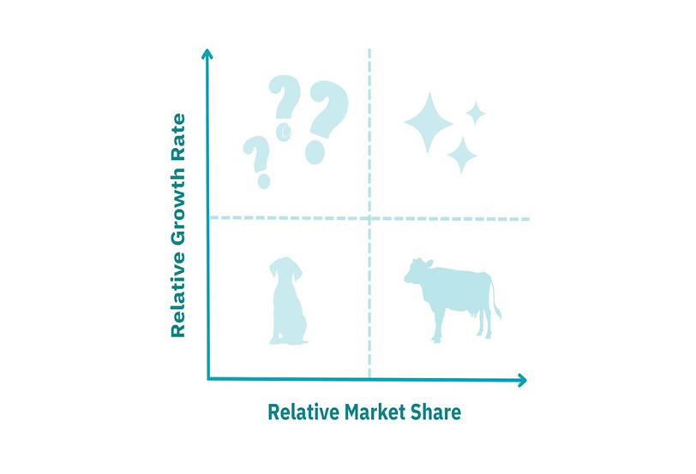
EQUITY RESEARCH REPORT
PIDILITE INDUSTRIES LTD.
BCG MATRIX
The Boston Consulting Group Matrix (BCG Matrix), also referred to as the product portfolio matrix, is a business planning tool used to evaluate the strategic position of a firm’s brand portfolio.
The BCG Matrix is one of the most popular portfolio analysis methods. It classifies a firm’s product and/or services into a two-by-two matrix. Each quadrant is classified as low or high performance, depending on the relative market share and market growth rate.
The horizontal axis of the BCG Matrix represents the amount of market share of a product and its strength in the particular market.
While, the vertical axis of the BCG Matrix represents the growth rate of a product and its potential to grow in a particular market.
Stars
Pidilite's flagship product, Fevicol, commands a 70% market share in the adhesives industry and is considered a star.
As a market leader, Fevicol generates high revenue and requires ongoing investment to maintain its dominant position and capitalize on the growing market.
The demand for adhesives is consistently rising due to increased construction activities and furniture manufacturing, making Fevicol a star product.
Question Marks
Pidilite's newer or less established product lines that are experiencing high market growth but have low market share would fall into this quadrant.
Products related to construction chemicals and art and craft supplies fall under the category of question marks.
Pidilite has yet to achieve a commanding presence in the DIY segment. Strategic investments in targeted marketing and product innovation could enable these offerings to gain traction and become leading players in the market.
The construction chemicals sector is witnessing robust growth, creating significant opportunities for Pidilite to enhance its market share through targeted initiatives and strategic partnerships.
Cash Cows
Pidilite's well-established, mature products with high market share but low growth potential are categorized as cash cows. These products are Dr. Fixit, M-seal, and Fevikwik.
The sealant market is relatively stable with moderate growth, making M-Seal a cash cow that generates steady revenue.
Despite being in a low-growth adhesive sub-segment, Fevikwik has high brand recognition and market share, contributing consistently to the company's profits.
These brands, while not as dominant as Fevicol, still command significant market share in their respective categories. As mature, cash-generating products, they are classified as cash cows.
Dogs
Pidilite's products with low market share and low growth are considered dogs. Example: Industrial adhesives and furniture accessories.
The industrial adhesives segment is mature and exhibits limited growth, which has resulted in Pidilite maintaining a smaller market share in this area.

Slide 11
EQUITY RESEARCH REPORT
PIDILITE INDUSTRIES LTD.
Porter's Five Forces Analysis
Threat of New Entrants:
The industry has moderate to high entry barriers, which reduces the danger of new entrants since new enterprises and companies will find it difficult to compete with current competitors for the same proportion of customers. The sector is governed by government rules and agencies that impose strict entry requirements based on their criteria.
There is no easy access to suppliers or distribution channels, which reduces the likelihood of new entrants joining the business. The larger potential for development and profit also draws in new participants, who, however, find it very hard to enter the expanding business.
Threat of Substitute Products:
The danger of replacements is seen as minimal for Pidilite Industries. This is partly due to the absence of replacements in the home country as well as the availability of substitutes for a specialized customer sector in overseas markets. As a result, these replacements are expensive. Using alternative items incurs significant switching costs.
Substitute items may be imported, but they will incur additional customs fees and expenses, raising the product's price.
Pidilite Industries substitute products are not widely accessible on the market. Because of their limited demand and exclusivity, the alternative items are only offered at a few shops and through exclusive channels.
Bargaining Power of Suppliers:
The bargaining power of suppliers is moderate. Pidilite sources key raw materials like resins and chemicals, which are generally abundant. However, price fluctuations can impact profitability. Pidilite's scale and consistent demand give it some leverage in negotiating with suppliers, but disruptions can still pose challenges.
Bargaining Power of Buyers:
By expanding and diversifying their customer base, Pidilite Industries can manage buyers' bargaining power. It is possible to do this by launching new items, targeting new market segments, and using product diversification techniques.
Marketing and marketing methods might also be beneficial in this situation. Building loyalty by incorporating innovation and providing an exceptional customer experience can boost their bargaining power. Pidilite industries can use these tactics to improve their market competitiveness.
Competitive Rivalry:
The market has many regional and national players, leading to fierce competition. Yet, Pidilite stands out from the crowd. Its strong brand reputation, wide array of products, and far-reaching distribution channels give it a big leg up. These factors help Pidilite stay at the top of the market even with all the rivals nipping at its heels.

Slide 12
EQUITY RESEARCH REPORT
PIDILITE INDUSTRIES LTD.
STRENGTH
STRENGTH
WEAKNESS
Dominant Market Position:
Pidilite stands as India's top adhesive and sealant firm, with a powerful market presence built on well-known brands such as Fevicol and Dr Fixit.
Product Portfolio Concentration:
The company's heavy reliance on the adhesive and sealant segment makes it vulnerable to market shifts or disruptions in this specific category and its strong R&D focus drives innovation and adaptation to evolving market needs.
Robust Brand Reputation:
Pidilite has created a solid reputation for high-quality products and new ideas. The deep trust and loyalty customers have for the Fevicol brand cement its top spot in the market.
Sensitivity to Input Costs:
Fluctuations in raw material and energy costs can
significantly affect Pidilite's profitability,
especially if the company cannot adjust
product prices to offset these increases.
SWOT
ANALYSIS
Product Diversification:
Pidilite can expand into related
product categories within the adhesive and construction chemical markets, leveraging its existing customer base and distribution network for growth.
Economic Vulnerabilities:
Economic factors like inflation, consumer
spending, and currency fluctuations impact product demand and profitability.
International Expansion:
By further penetrating global markets, particularly in emerging economies, Pidilite can diversify its revenue streams and reduce reliance on the domestic market.
Plastic Waste Management Regulations:
New plastic waste management regulations require increased use of recycled materials and improved packaging recycling, potentially impacting operational costs.
OPPORTUNITIES
THREATS

Slide 13
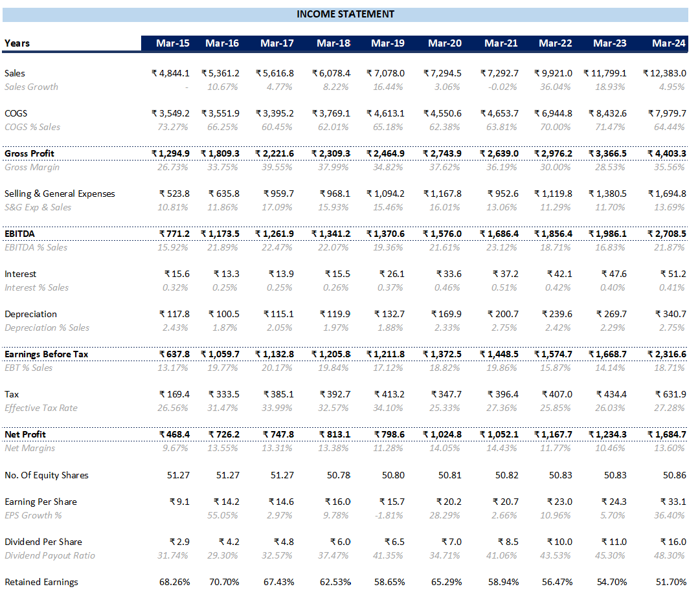
EQUITY RESEARCH REPORT
PIDILITE INDUSTRIES LTD.
INCOME STATEMENT ANALYSIS
Revenues
The revenue has grown with a growth rate (CAGR) of around 10%. R&D innovations contributed to improve the revenue and margin growth by launching new products, product/process improvement and cost saving initiatives, capacity debottlenecking, solutions for market needs for new applications and improved environmental compliance.

Slide 14
EQUITY RESEARCH REPORT
PIDILITE INDUSTRIES LTD.
Cost Of Goods Sold (COGS)
The Cost Of Goods Sold (COGS) stood at ₹ 8,432.6 in FY23 against the sales of ₹ 11,799.1 in FY23. However, the COGS declined in FY24 to ₹ 7,979.7 against the sales of ₹ 12,383.0 . It is worth noting that the Cost of Goods Sold as % of Sales declined by 7.03% from 71.47% to 64.44%. The decrease in cost is mainly because of significant crash in prices of Crude Oil during FY24.
Profitability
The EBITDA has grown with an impressive growth rate (CAGR) OF 13.39%. In the current year the EBITDA has increased from ₹1,986.1 Cr to ₹2708.5 Cr showing a massive growth of 36.37% YoY.
The Net Profit has increased in the current fiscal year from ₹ 1,234.3 Cr to ₹ 1,684.7 Cr. The increase in profitability is primarily due to cost reduction.
Earnings Per Share (EPS)
The Earnings Per Share (EPS) of the Pidilite Industries has increased massively from mere ₹ 9.1 in FY15 to ₹ 33.1 in FY24 implying an impressive increase of 263%. The increase in EPS is on account of Increase in Net Profits of the company. Moreover, the company has not issued any kind of shares in the last 10 years. In FY24, it increased by ₹ 8.8 from ₹ 24.3 to ₹ 33.1.
Interest
The interest expense of the Pidilite Industries has remained flat in the last 3 years. Though it has been increasing in the absolute terms, but Interest as % of sales has been revolving around 0.40%.
The median interest expense as % of sales is 0.4%, indicating that the company has been successful in keeping its interest expense under its control.

Slide 15
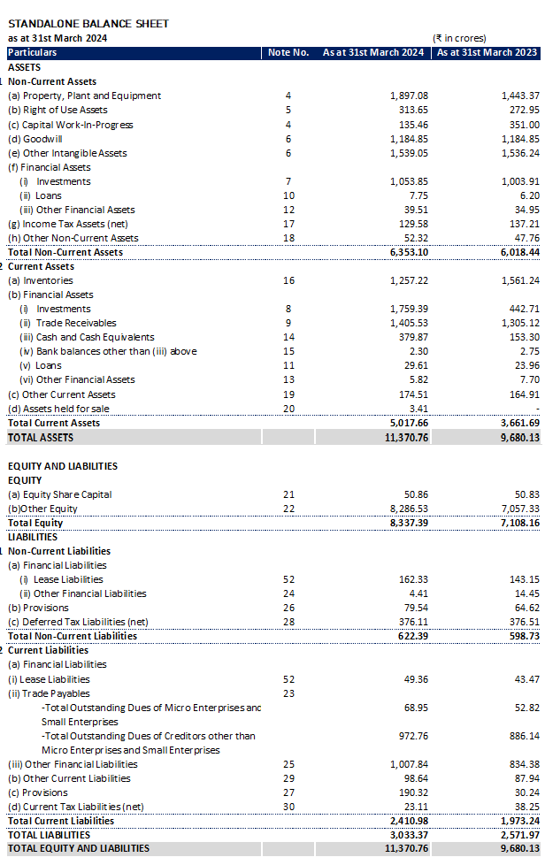
EQUITY RESEARCH REPORT
PIDILITE INDUSTRIES LTD.
BALANCE SHEET ANALYSIS

Slide 16
EQUITY RESEARCH REPORT
PIDILITE INDUSTRIES LTD.
Non Current Assets
The Non Current Assets has increased by ₹ 334.66 from ₹6018.44 Cr in FY23 to ₹6353.1 Cr in FY24. This is an increase of 5.56% YOY. The increase in Non Current Assets is primarily driven by investment in Property, Plant & Equipment (PPE).
However, the Capital Work-in-progress has fallen by more than 61%. This is because during the FY24, the company has capitalised its work by around ₹397.43 Cr.
Current Assets
The company has increased its investments in the Mutual Funds from ₹442 Cr in FY23 to FY24 ₹1759 Cr which is a whopping increase of 297%. This increase in the Investments has led to an increase of ₹1355.97 Cr. The cash and cash equivalents has also increased during this period signifying that the company has been effectively recovering the cash from its debtors and having a good bargaining power with suppliers.
During this period, the Inventory has fallen by ₹304 Cr implying a decrease of more than 19%.
Equity & Liabilities
The Pidilite Industries has not issued any kind of shares to the public during the FY24. However, the company has issued around 3 Lakh shares during the year on exercise of options under Employee Stock Option Plan-2016.
The Depreciation of Right-of-use assets has increased by ₹14.24 Cr from ₹42.03 Cr in FY23 to ₹56.27 Cr in FY24. Also, during this period, the interest on Lease Liabilities has increased by more than 40%.
The Retained Earnings of the company has increased by ₹1220.13 Cr from ₹5628.19 Cr in FY23 to ₹6848.32 Cr in FY24. This has caused the Equity to increase by more than ₹1200 Cr.
Current Liabilities
The dues payable to MSME’s has increased from 52.82 Cr in FY23 to 68.95 Cr in FY24 while to others, it increased from 667.58 to 818.91 Cr. Employee related liabilities has increased by more than 520% since the company has reclassed certain employee related liabilities from “Liabilities for expenses” to Employee related liabilities.
As a result, the current liabilities of the company has increased by 437.34 Cr in this fiscal year.

Slide 17
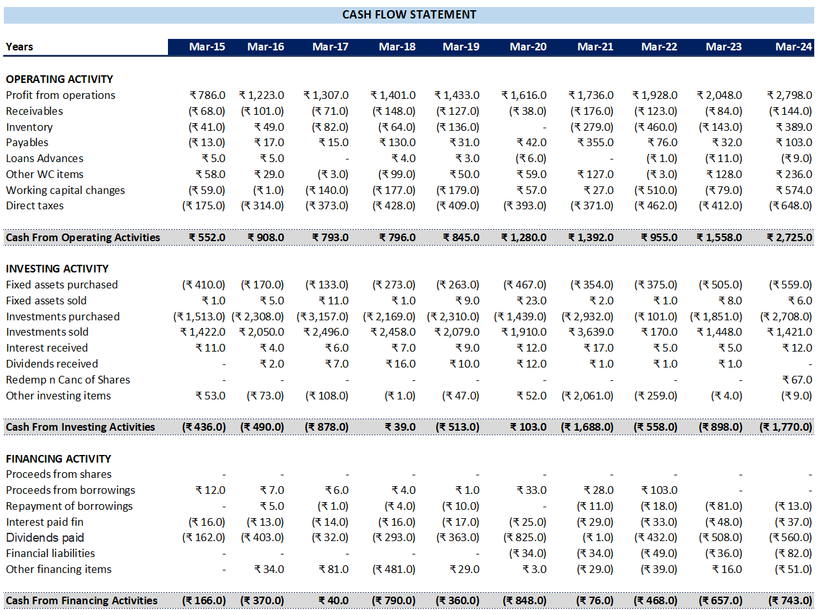
EQUITY RESEARCH REPORT
PIDILITE INDUSTRIES LTD.
CASH FLOW STATEMENT ANALYSIS
Cash Flow from Operating Activities
The company's Cash Flow from Operations (CFO) has increased by approximately 110% in last 5 years, largely due to higher operational profits. This growth in CFO is a positive sign, reflecting the company's improved financial performance. A key contributor to this increase is the noticeable improvement in the cash conversion cycle, driven by a strategic increase in payables and a reduction in inventory levels.
However, there are areas that require attention. A significant concern is the rise in trade receivables, which has negatively impacted the CFO. This increase in receivables may indicate a potential decline in the quality of earnings, suggesting that while cash flow has improved, the company might be facing challenges in collecting payments from customers.

Slide 18
EQUITY RESEARCH REPORT
PIDILITE INDUSTRIES LTD.
Cash Flow from Investing Activities
The net cash outflow from investing activities has nearly quadrupled, primarily due to the company’s increased investment in purchasing fixed assets and additional investments. Pidillite has consistently allocated a significant portion of its cash flows towards acquiring investments. However, in the most recent period, the company partially redeemed some of its investments in shares of other companies.
An increase in capital expenditures (CAPEX), such as purchasing new machinery, expanding production facilities, or investing in new technologies, often signals that a company is preparing to meet higher future demand. This increase in Investing Activity of Pidilite Industries indicates confidence in the company’s growth prospects.
Cash Flow from Financing Activities
The most significant constituents of financing cash outflows have been its payment to shareholders in the form of dividends and repayment of its financial liabilities. The dividend payments accounts for 75% of the cash outflow from Financing Activity. The interest paid varies around 8-12% of its existing debt. The Company has not issued any kind of shares in the last 10 years.
We can conclude by looking at the constituents of Financing Activity that the company has not been taking Debt or issuing Debentures from the past 2 years. Moreover, during this period, the company has been aggressively paying its debt. This indicates that the Company’s vision is to get debt free in next 1-2 years, thus reducing the interest cost and overall increasing the cash.
2021

Slide 19
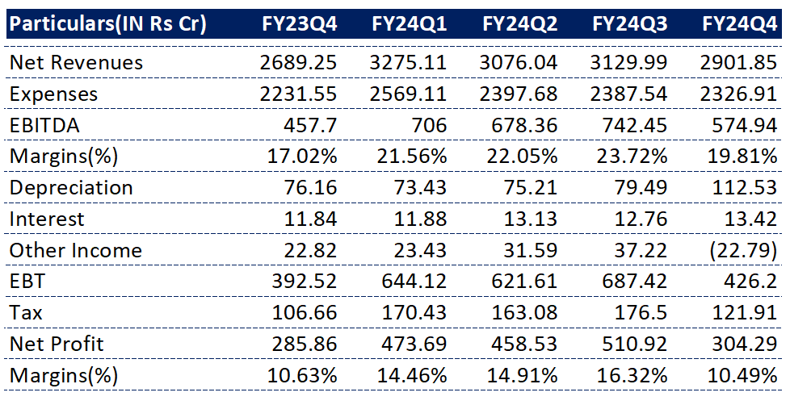
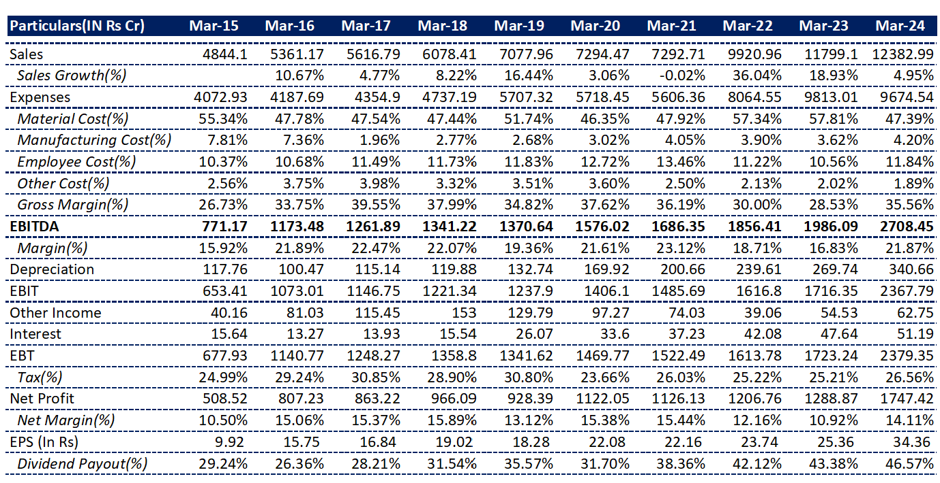
EQUITY RESEARCH REPORT
PIDILITE INDUSTRIES LTD.
Quarterly Snapshot
Annual Snapshot

Slide 20
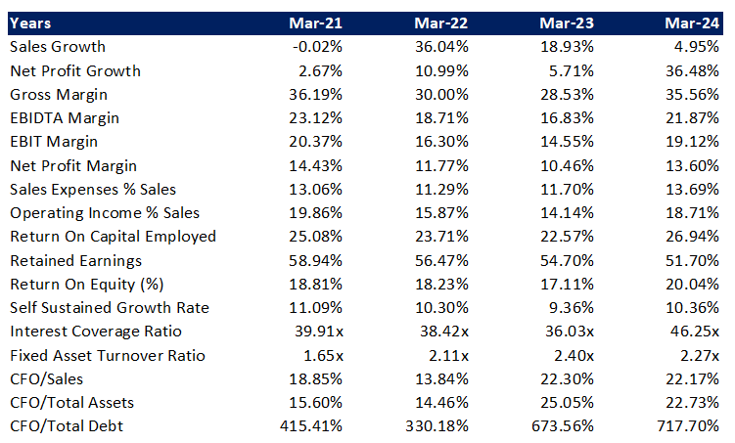
Academic Research Project – Not a recommendation
EQUITY RESEARCH REPORT
PIDILITE INDUSTRIES LTD.
PIDILITE INDUSTRIES LTD.
RATIO ANALYSIS
Liquidity Ratios:
Pidilite has maintained a strong liquidity position throughout the period, with a current ratio consistently above 1.5 and a quick ratio above 1.0. This indicates the company's ability to meet its short-term obligations comfortably.
Leverage Ratios:​
The company has significantly reduced its debt-to-equity ratio from 0.68 in Mar-21 to 0.04 in Mar-24, indicating a stronger financial position and reduced reliance on debt financing.​
The interest coverage ratio has remained consistently high, demonstrating Pidilite's ability to comfortably service its debt obligations.​

Slide 21
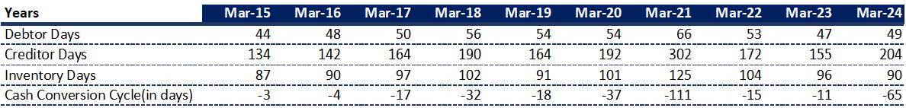
EQUITY RESEARCH REPORT
PIDILITE INDUSTRIES LTD.
Efficiency Ratios:
The fixed asset turnover ratio has improved over the years, suggesting more efficient use of fixed assets.
The inventory turnover ratio has remained relatively stable, indicating efficient management of inventory.
Profitability Ratios:
Pidilite has demonstrated consistent profitability, with a slight decline in net profit margin from Mar-21 to Mar-23, but a rebound in Mar-24.
The return on equity (ROE) and return on assets (ROA) have remained relatively stable, indicating efficient use of capital.
The company's operating income as a percentage of sales has increased, suggesting improved operational efficiency.
Market Value Ratios :
The P/E ratio has fluctuated over the years, but it remains relatively high, suggesting that the market is placing a premium on Pidilite's growth prospects.
The P/B ratio has also increased over time, indicating that the market values Pidilite's assets at a premium compared to their book value.
The Cash Conversion Cycle of Pidilite Industries has been negative for the last 10 years which is a positive sign for the business.
The Debtor Days of the company is 49 days indicating that it takes more than 1.5 months to receive the dues from the customers.
The Creditor days is 204 days depicting huge bargaining power with its vendors. The Inventory days is 90 days which means that the company has to keep inventory of 90 days for itself. In another words, the money of about 3 months worth of sales is tied up in inventory for the company.

Slide 22
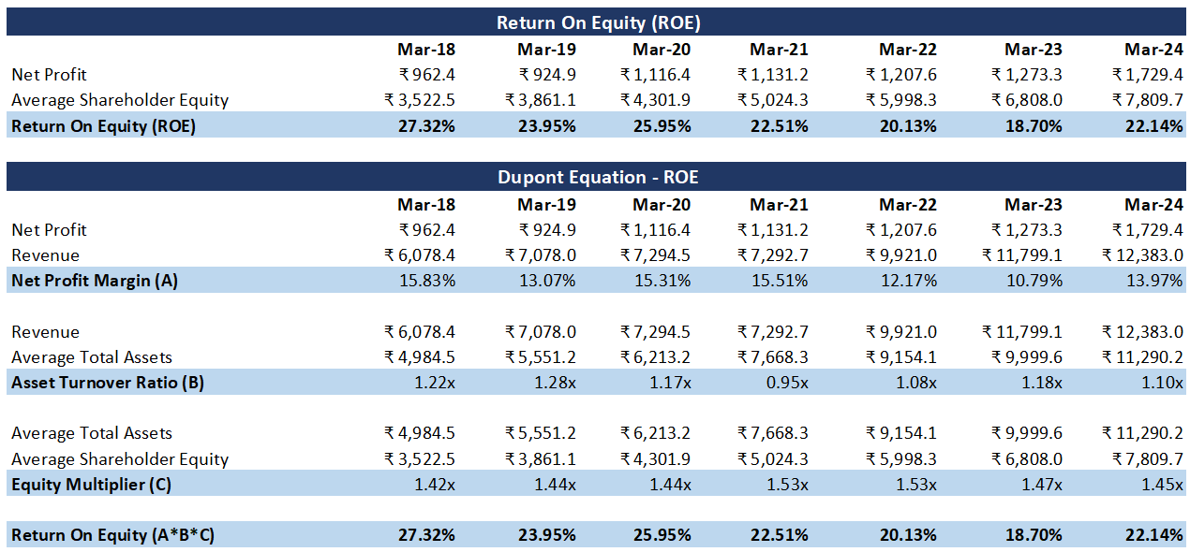
EQUITY RESEARCH REPORT
PIDILITE INDUSTRIES LTD.
Revenues (INR Crs)
Net Profit (INR Crs)
Average Total Asets (INR Crs)
ROE (%)
Return On Assets (%)
Financial Leverage

Slide 23
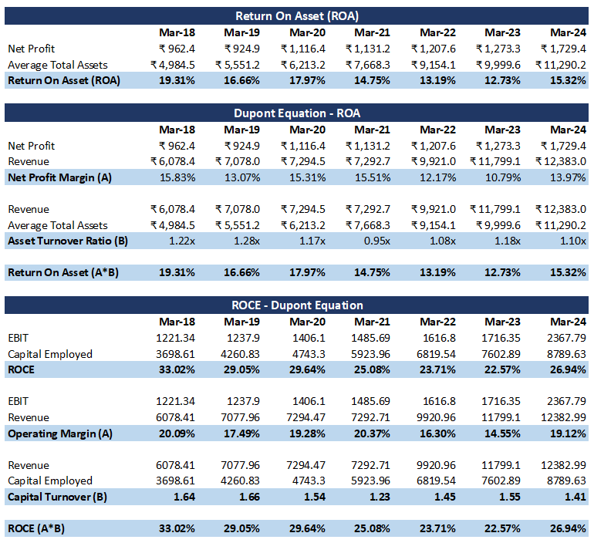
EQUITY RESEARCH REPORT
PIDILITE INDUSTRIES LTD.
Dupont Analysis: Return on Equity and Return on Assets (2/2)
Commentary:
The ROE of the company fell significantly from 27.32% to 22.51% in FY21 due to Covid-19 and now has recovered to 22.14% ROE in FY24, management has been reiterating its focus on improvement in productivity and thus we have seen an improvement in ROE.
The improvement in ROE is driven by an increase in Asset Turnover Ratio from 0.95x in FY21 to 1.10x in FY24. This indicates that the company has been using its assets quite efficiently.
It is worth noting that the company has reduced its financial leverage from 1.53x during Covid period to 1.45x in FY24. However, during the period FY18-FY24, it has almost remained flat.
Net Profit Margin of the company has slightly decreased from 15.83% in FY18 to 13.97% in FY24, which resulted in ROA to decrease from 19.31% to 15.32% during this period. However, ROA has reached the covid levels of 15% in FY24, implying the company’s ability to generate returns on the assets of the company.
The Capital Turnover of the Pidilite Industries has significantly decreased from 1.64x in FY18 to 1.41x in FY24. However, the operating margin has remained flat during the same period. Hence, ROCE of the company has decreased signifying that the return generated on the total capital has fell. This shows the inefficiency of the management to generate returns.

Slide 24
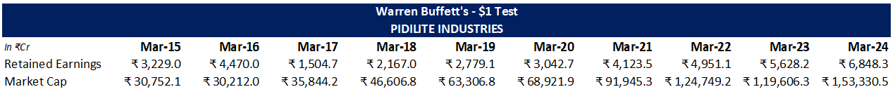
EQUITY RESEARCH REPORT
PIDILITE INDUSTRIES LTD.
The Warren Buffet’s $1 Test
The "One Dollar Test" is a concept attributed to Warren Buffett, often discussed in the context of evaluating the effectiveness of a company's management in generating shareholder value. The idea behind this test is simple: for every dollar of retained earnings (profits not paid out as dividends but reinvested back into the company), the market value of the company should increase by at least one dollar.
According to Buffett's test, if management is using retained earnings wisely, the company's stock price (and thus its market capitalization) should increase by at least the amount of the retained earnings. In other words, if a company retains $1 billion of earnings, its market value should rise by at least $1 billion.
Implication of The $1 Test
Buffett uses this test to evaluate whether a company is a good investment. If a company consistently passes the One Dollar Test, it implies that the management is making good decisions with retained earnings, which is a positive indicator for long-term investors.
The One Dollar Test encourages companies to think carefully about how they allocate retained earnings. If a company cannot generate at least a dollar of market value for every dollar retained, it may be better off distributing the earnings to shareholders as dividends or buying back shares.
Key Figures:
Change in Market Cap=₹ 1,22,578.38
Retained Earnings= ₹3,619.3
$1 Test
Test Statistic= Change in Market Capitalisation
Retained Earnings
= ₹ 1,22,578.38
₹3,619.3
= 33.86
₹ 1,22,578.38
₹ 5,808.9
Conclusion:
Pidilite Industries Ltd. achieves a ratio of 33.86, indicating that for every ₹1 of retained earnings, the company has generated approximately ₹33.86 in market value. This figure is significantly above the baseline of 1, suggesting that Pidilite Industries Ltd. has efficiently utilized its retained earnings to create substantial value for its shareholders. The high ratio highlights the company’s effective capital allocation strategies and its ability to expand its market presence and profitability over time.​
​The analysis confirms that Pidilite Industries Ltd. has successfully passed Warren Buffett's $1 Test with a remarkable ratio of 33.86. This performance reflects the company’s robust financial health and its ability to enhance shareholder value through prudent reinvestment of earnings. Consequently, Pidilite Industries Ltd. emerges as a potentially attractive investment, given its consistent track record of value creation.​

Slide 25
EQUITY RESEARCH REPORT
PIDILITE INDUSTRIES LTD.
COFFEE CAN INVESTING
What is coffee can investing?
The "Coffee Can Investing Strategy" is a passive investment strategy that involves selecting high-quality stocks and holding them for an extended period, often decades, with minimal intervention. This approach is inspired by the analogy of storing valuables in a coffee can and forgetting about them, which implies carefully selecting companies with robust fundamentals and promising growth prospects over extended periods. By this strategy investors aim to capitalize on the power of compounding returns and achieve significant wealth accumulation.
Here's a brief Overview of the Coffee Can Investing Strategy-
Key Principles
High-Quality Stocks-
Prioritize companies with solid financial foundations, consistent profitability, competitive edge and with a history of delivering consistent returns.
Long-Term Horizon:-
Embrace a long-term perspective and harnessing the power of compounding to maximize returns by focusing on the underlying value of high-quality companies instead of doing trade based on short-term market fluctuations.
Minimal Intervention:-
Minimize trading activity and avoiding emotional decision-making, will allow investments to grow organically over time as well as harnessing the power of time and compound returns, ultimately maximizing the long-term value of investments.
Diversify Strategically:-
Diversify portfolio across various sectors to mitigate the risk while maintaining a manageable number of high-conviction stocks. This strategic approach helps to balance the potential for higher returns with the need to manage risk, enhancing portfolio's resilience to market fluctuations.
Coffee Can Investing Criteria:​
Long-Term Growth: Pidilite's consistent revenue growth and strong financial performance align with the long-term focus of coffee can investing.​
Quality Fundamentals: The company's strong ROCE, market capitalization, and brand recognition indicate solid fundamentals.​
Minimal Intervention: Pidilite's focus on its core business and avoidance of frequent acquisitions or divestments support a minimal intervention approach.​

Slide 26
EQUITY RESEARCH REPORT
PIDILITE INDUSTRIES LTD.
Assessing Pidilite Industries Ltd.
Company Existence: Pidilite Industries Ltd. was established in 1969, well exceeding the 10-year requirement.
ROCE: The company has consistently maintained a strong ROCE over the past 10 years, with figures ranging from 24% to 45%. This indicates efficient capital utilization and a healthy business model.
Brand Value: As a well-established brand in India, particularly known for its Fevicol adhesive, Pidilite enjoys a strong brand value that provides a competitive advantage.
Revenue Growth: Pidilite has exhibited consistent revenue growth, with a compounded annual growth rate (CAGR) of approximately 10.6% over the past 10 years. This demonstrates the company's ability to expand its market share and increase sales.
Market Capitalization: With a market capitalization of ₹1,56,888 crores, Pidilite is a large-cap company that offers stability and potential for long-term growth.
Competitive Edge: Pidilite's diverse product portfolio, strong distribution network, and research and development capabilities give it a competitive edge in the market.
10 Year ROCE(%) of Pidilite Industries Ltd.
Conclusion:
​ Pidilite Industries Ltd. demonstrates strong potential for coffee can investing, characterized by its consistent revenue growth, robust financial performance, and alignment with the strategy's key principles. The company's long-term focus, strong fundamentals, and potential for sustainable growth make it a compelling investment opportunity.​

